Slide 1
Aggregating Data
Using Group Functions
Notes:
Schedule: Timing Topic
35 minutes Lecture
40 minutes Practice
75 minutes Total

Slide 2
Objectives
After completing this lesson, you should be able to
do the following:
Identify the available group functions
Describe the use of group functions
Group data using the GROUP BY clause
Include or exclude grouped rows by using the HAVING clause
Notes:
Lesson Aim
This lesson further addresses functions. It focuses on obtaining summary information, such as averages, for groups of rows. It discusses how to group rows in a table into smaller sets and how to specify search criteria for groups of rows.

Slide 3
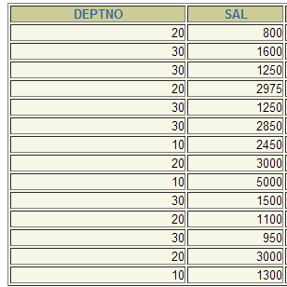
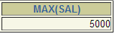
What Are Group Functions?
Group functions operate on sets of rows to give one result per group.
EMPLOYEES
The maximum
salary in
the EMPLOYEES
table.
Notes:
Group Functions
Unlike single-row functions, group functions operate on sets of rows to give one result per group. These sets may be the whole table or the table split into groups.

Slide 4
Types of Group Functions
AVG
COUNT
MAX
MIN
STDDEV
SUM
VARIANCE
Notes:
Group Functions (continued)
Each of the functions accepts an argument. The following table identifies the options that you can use in the syntax:

Slide 5
Group Functions Syntax
SELECT [column,] group_function(column), ...
FROM table
[WHERE condition]
[GROUP BY column]
[ORDER BY column];
Notes:
Guidelines for Using Group Functions
DISTINCT makes the function consider only nonduplicate values; ALL makes it consider every value including duplicates. The default is ALL and therefore does not need to be specified.
The data types for the functions with an expr argument may be CHAR, VARCHAR2, NUMBER, or DATE.
All group functions ignore null values. To substitute a value for null values, use the NVL, NVL2, or COALESCE functions.
The Oracle server implicitly sorts the result set in ascending order when using a GROUP BY clause. To override this default ordering, DESC can be used in an ORDER BY clause.
Instructor Note
Stress the use of DISTINCT and group functions ignoring null values. ALL is the default and is very rarely specified.

Slide 6
AVG Function
AVG([DISTINCT|ALL]n)
Average Value of n, ignoring null values.

Slide 7
SUM Function
SUM ([DISTINCT|ALL]n)
Sum Values of n, ignoring null values.

Slide 8
MAX Function
MAX ([DISTINCT|ALL]expr)
Maximum value of expr, ignoring null values.

Slide 9
MIN Function
MIN ([DISTINCT|ALL]expr)
Minimum value of expr, ignoring null values.

Slide 10
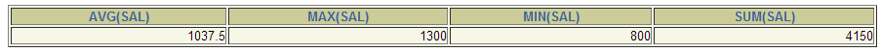
Using the AVG and SUM Functions
You can use AVG and SUM for numeric data.
SELECT AVG(sal), MAX(sal),
MIN(sal), SUM(sal)
FROM emp
WHERE job LIKE '%CL%';
Notes:
Group Functions
You can use AVG, SUM, MIN, and MAX functions against columns that can store numeric data. The example on the slide displays the average, highest, lowest, and sum of monthly salaries for all sales representatives.

Slide 11
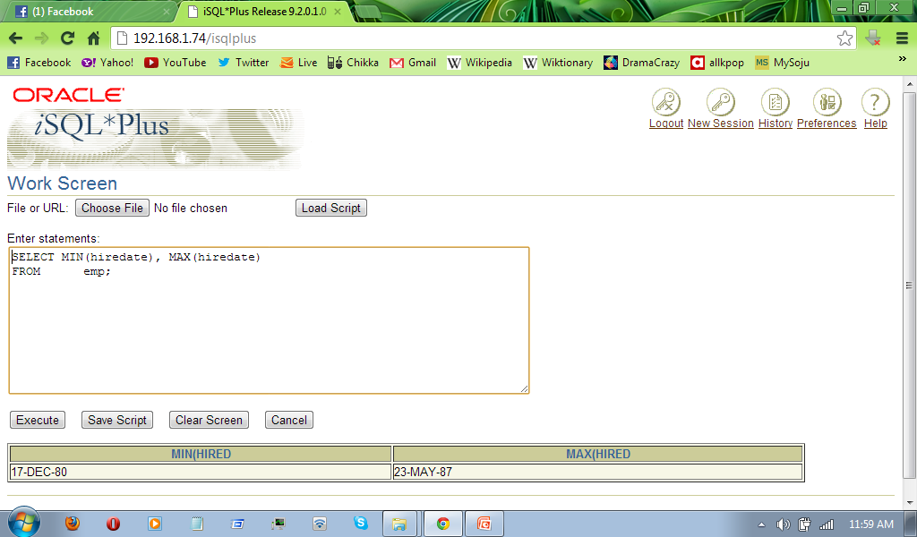
Using the MIN and MAX Functions
You can use MIN and MAX for any data type.
SELECT MIN(hiredate), MAX(hiredate)
FROM emp;
Notes:
Group Functions (continued)
You can use the MAX and MIN functions for any data type. The slide example displays the most junior and most senior employee.
The following example displays the employee last name that is first and the employee last name that is the last in an alphabetized list of all employees.
SELECT MIN(last_name), MAX(last_name)
FROM employees;
Note: AVG, SUM, VARIANCE, and STDDEV functions can be used only with numeric data types.

Slide 12
STDDEV Function
STDDEV([DISTINCT|ALL]x)
Standard deviation of n, ignoring null values.
In statistics and probability theory, standard deviation (represented by the symbol sigma, σ) shows how much variation or "dispersion" exists from the average (mean, or expected value). A low standard deviation indicates that the data points tend to be very close to the mean; high standard deviation indicates that the data points are spread out over a large range of values.

Slide 13
VARIANCE Function
VARIANCE([DISTINCT|ALL]x)
Variance of n, ignoring null values.
In probability theory and statistics, the variance is a measure of how far a set of numbers is spread out. It is one of several descriptors of a probability distribution, describing how far the numbers lie from the mean (expected value). In particular, the variance is one of the moments of a distribution. In that context, it forms part of a systematic approach to distinguishing between probability distributions. While other such approaches have been developed, those based on moments are advantageous in terms of mathematical and computational simplicity.

Slide 14
COUNT Function
COUNT ({*|[DISTINCT|ALL]expr})
Number of rows, where expr evaluates to something other than null (count all selected rows using *, including duplicates and rows with nulls)

Slide 15
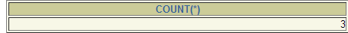
Using the COUNT Function
COUNT(*) returns the number of rows in a table.
SELECT COUNT(*)
FROM emp
WHERE deptno = 10;
Notes:
The COUNT Function
The COUNT function has three formats:
COUNT(*)
COUNT(expr)
COUNT(DISTINCT expr)
COUNT(*) returns the number of rows in a table that satisfy the criteria of the SELECT statement, including duplicate rows and rows containing null values in any of the columns. If a WHERE clause is included in the SELECT statement, COUNT(*) returns the number of rows that satisfies the condition in the WHERE clause.
In contrast, COUNT(expr) returns the number of non-null values in the column identified by expr.
COUNT(DISTINCT expr) returns the number of unique, non-null values in the column identified by expr.
The slide example displays the number of employees in department 50.
Instructor Note
Demo: 5_count1.sql, 5_count2.sql
Purpose: To illustrate using the COUNT(*) and COUNT(expr) functions

Slide 16
Group Function
AVG, SUM, VARIANCE, and STDDEV functions can be used only with numeric data types.
SELECT MIN(ename), MAX(ename)
FROM emp;
Notes:
The COUNT Function
The COUNT function has three formats:
COUNT(*)
COUNT(expr)
COUNT(DISTINCT expr)
COUNT(*) returns the number of rows in a table that satisfy the criteria of the SELECT statement, including duplicate rows and rows containing null values in any of the columns. If a WHERE clause is included in the SELECT statement, COUNT(*) returns the number of rows that satisfies the condition in the WHERE clause.
In contrast, COUNT(expr) returns the number of non-null values in the column identified by expr.
COUNT(DISTINCT expr) returns the number of unique, non-null values in the column identified by expr.
The slide example displays the number of employees in department 50.
Instructor Note
Demo: 5_count1.sql, 5_count2.sql
Purpose: To illustrate using the COUNT(*) and COUNT(expr) functions

Slide 17
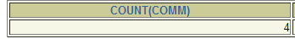
Using the COUNT Function
COUNT(expr) returns the number of rows with non-null values for the expr.
Display the number of department values in the EMPLOYEES table, excluding the null values.
SELECT COUNT(comm)
FROM emp;
Notes:
The COUNT Function (continued)
The slide example displays the number of employees in department 80 who can earn a commission.
Example
Display the number of department values in the EMPLOYEES table.
SELECT COUNT(department_id)
FROM employees;

Slide 18
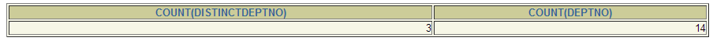
Using the DISTINCT Keyword
COUNT(DISTINCT expr) returns the number of distinct non-null values of the expr.
Display the number of distinct department values in the EMPLOYEES table.
SELECT COUNT(DISTINCT deptno), COUNT(deptno)
FROM emp;
Notes:
The DISTINCT Keyword
Use the DISTINCT keyword to suppress the counting of any duplicate values within a column.
The example on the slide displays the number of distinct department values in the EMPLOYEES table.

Slide 19
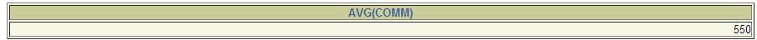
Group Functions and Null Values
Group functions ignore null values in the column.
SELECT AVG(comm)
FROM emp;
Notes:
Group Functions and Null Values
All group functions ignore null values in the column. In the slide example, the average is calculated based only on the rows in the table where a valid value is stored in the COMMISSION_PCT column. The average is calculated as the total commission paid to all employees divided by the number of employees receiving a commission (four).

Slide 20
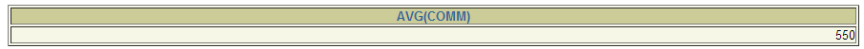
Using the NVL Function with Group Functions
The NVL function forces group functions to include
null values.
SELECT AVG(NVL(comm, 0))
FROM emp;
Notes:
Group Functions and Null Values (continued)
The NVL function forces group functions to include null values. In the slide example, the average is calculated based on all rows in the table, regardless of whether null values are stored in the COMMISSION_PCT column. The average is calculated as the total commission paid to all employees divided by the total number of employees in the company (20).

Slide 21
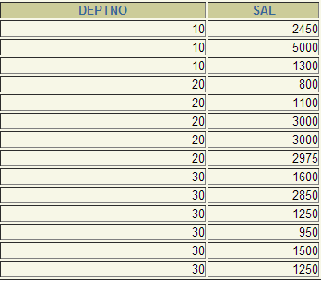
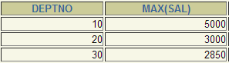
What Are Group Functions?
Group functions operate on sets of rows to give one result per group.
EMPLOYEES
The maximum
salary in
the EMPLOYEES
Table for each
department
Notes:
Group Functions
Unlike single-row functions, group functions operate on sets of rows to give one result per group. These sets may be the whole table or the table split into groups.

Slide 22


Creating Groups of Data
EMPLOYEES
4400
9500
The
average
salary
in
EMPLOYEES
table
for each
department.
3500
6400
10033
…
Notes:
Groups of Data
Until now, all group functions have treated the table as one large group of information. At times, you need to divide the table of information into smaller groups. This can be done by using the GROUP BY clause.

Slide 23
Creating Groups of Data:
The GROUP BY Clause Syntax
SELECT column, group_function(column)
FROM table
[WHERE condition]
[GROUP BY group_by_expression]
[ORDER BY column];
Divide rows in a table into smaller groups by using the
GROUP BY clause.
Notes:
The GROUP BY Clause
You can use the GROUP BY clause to divide the rows in a table into groups. You can then use the group functions to return summary information for each group.
In the syntax:
group_by_expression specifies columns whose values determine the basis for
grouping rows
Guidelines
If you include a group function in a SELECT clause, you cannot select individual results as well, unless the individual column appears in the GROUP BY clause. You receive an error message if you fail to include the column list in the GROUP BY clause.
Using a WHERE clause, you can exclude rows before dividing them into groups.
You must include the columns in the GROUP BY clause.
You cannot use a column alias in the GROUP BY clause.
By default, rows are sorted by ascending order of the columns included in the GROUP BY list. You can override this by using the ORDER BY clause.

Slide 24
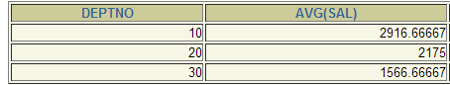
Using the GROUP BY Clause
All columns in the SELECT list that are not in group
functions must be in the GROUP BY clause.
SELECT deptno, AVG(sal)
FROM emp
GROUP BY deptno;
Notes:
The GROUP BY Clause (continued)
When using the GROUP BY clause, make sure that all columns in the SELECT list that are not group functions are included in the GROUP BY clause. The example on the slide displays the department number and the average salary for each department. Here is how this SELECT statement, containing a GROUP BY clause, is evaluated:
The SELECT clause specifies the columns to be retrieved:
Department number column in the EMPLOYEES table
The average of all the salaries in the group you specified in the GROUP BY clause
The FROM clause specifies the tables that the database must access: the EMPLOYEES table.
The WHERE clause specifies the rows to be retrieved. Since there is no WHERE clause, all rows are retrieved by default.
The GROUP BY clause specifies how the rows should be grouped. The rows are being grouped by department number, so the AVG function that is being applied to the salary column will calculate the average salary for each department.
Instructor Note
Group results are sorted implicitly, on the grouping column. You can use ORDER BY to specify a different sort order, remembering to use only group functions, or the grouping column.

Slide 25

Using the GROUP BY Clause
The GROUP BY column does not have to be in the
SELECT list.
SELECT AVG(sal)
FROM emp
GROUP BY deptno;
Notes:
The GROUP BY Clause (continued)
The GROUP BY column does not have to be in the SELECT clause. For example, the SELECT statement on the slide displays the average salaries for each department without displaying the respective department numbers. Without the department numbers, however, the results do not look meaningful.
You can use the group function in the ORDER BY clause.
SELECT department_id, AVG(salary)
FROM employees
GROUP BY department_id
ORDER BY AVG(salary);
Instructor Note
Demonstrate the query with and without the DEPARTMENT_ID column in the SELECT statement.
…

Slide 26
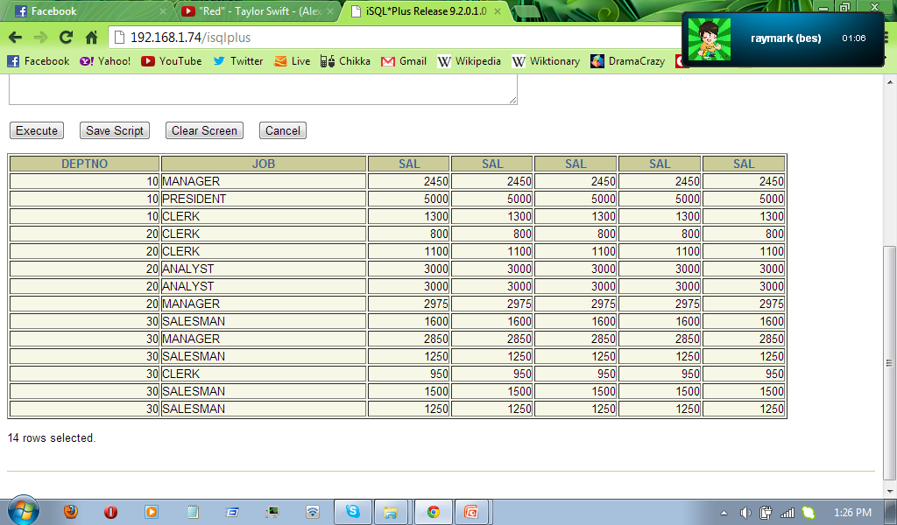
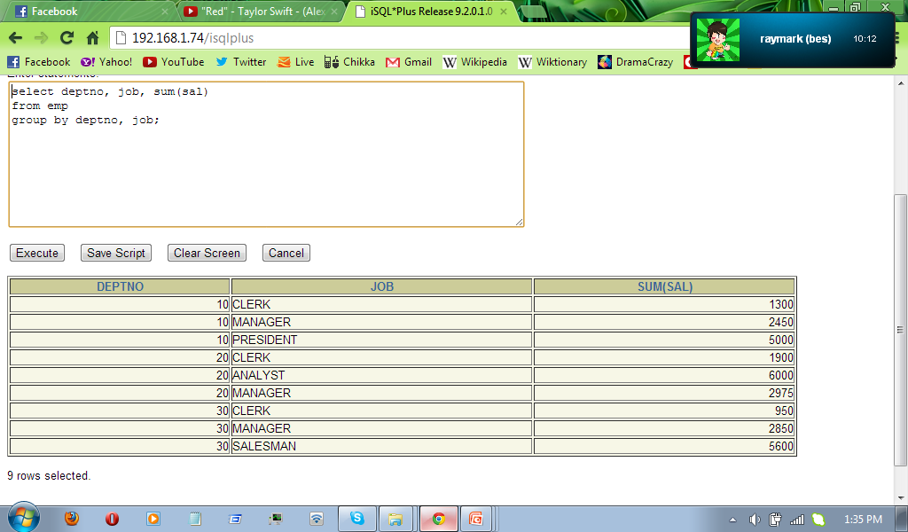
Grouping by More Than One Column
EMPLOYEES
“Add up the
salaries in
the EMPLOYEES
table
for each job,
grouped by
department.
Notes:
Groups within Groups
Sometimes you need to see results for groups within groups. The slide shows a report that displays the total salary being paid to each job title, within each department.
The EMPLOYEES table is grouped first by department number and, within that grouping, by job title. For example, the four stock clerks in department 50 are grouped together and a single result (total salary) is produced for all stock clerks within the group.
Instructor Note
Demo: 5_order1.sql, 5_order2.sql
Purpose: To illustrate ordering columns that are grouped by DEPARTMENT_ID first and ordering columns that are grouped by JOB_ID first.

Slide 27
Using the GROUP BY Clause on Multiple Columns
SELECT deptno, job, SUM(sal)
FROM emp
GROUP BY deptno, job;
Notes:
Groups within Groups (continued)
You can return summary results for groups and subgroups by listing more than one GROUP BY column. You can determine the default sort order of the results by the order of the columns in the GROUP BY clause. Here is how the SELECT statement on the slide, containing a GROUP BY clause, is evaluated:
The SELECT clause specifies the column to be retrieved:
Department number in the EMPLOYEES table
Job ID in the EMPLOYEES table
The sum of all the salaries in the group that you specified in the GROUP BY clause
The FROM clause specifies the tables that the database must access: the EMPLOYEES table.
The GROUP BY clause specifies how you must group the rows:
First, the rows are grouped by department number.
Second, within the department number groups, the rows are grouped by job ID.
So the SUM function is being applied to the salary column for all job IDs within each department number group.

Slide 28
Illegal Queries
Using Group Functions
Any column or expression in the SELECT list that is
not an aggregate function must be in the GROUP BY
clause.
SELECT deptno, COUNT(ename)
FROM emp;
SELECT deptno, COUNT(ename)
*
ERROR at line 1:
ORA-00937: not a single-group group function
Column missing in the GROUP BY clause
Notes:
Illegal Queries Using Group Functions
Whenever you use a mixture of individual items (DEPARTMENT_ID) and group functions (COUNT) in the same SELECT statement, you must include a GROUP BY clause that specifies the individual items (in this case, DEPARTMENT_ID). If the GROUP BY clause is missing, then the error message “not a single-group group function” appears and an asterisk (*) points to the offending column. You can correct the error on the slide by adding the GROUP BY clause.
SELECT department_id, count(last_name)
FROM employees
GROUP BY department_id;
Any column or expression in the SELECT list that is not an aggregate function must be in the GROUP BY clause.
Instructor Note
Demo: 5_error.sql
Purpose: To illustrate executing a SELECT statement with no GROUP BY clause
…

Slide 29
Illegal Queries
Using Group Functions
You cannot use the WHERE clause to restrict groups.
You use the HAVING clause to restrict groups.
You cannot use group functions in the WHERE clause.
SELECT deptno, AVG(sal)
FROM emp
WHERE AVG(sal) > 2500
GROUP BY deptno;
WHERE AVG(sal) > 8000
*
ERROR at line 3:
ORA-00934: group function is not allowed here
Cannot use the WHERE clause to restrict groups
Notes:
Illegal Queries Using Group Functions (continued)
The WHERE clause cannot be used to restrict groups. The SELECT statement on the slide results in an error because it uses the WHERE clause to restrict the display of average salaries of those departments that have an average salary greater than $8,000.
You can correct the slide error by using the HAVING clause to restrict groups.
SELECT department_id, AVG(salary)
FROM employees
HAVING AVG(salary) > 8000
GROUP BY department_id;

Slide 30
Excluding Group Results
EMPLOYEES
The maximum
salary
per department
when it is
greater than
$2,500
Notes:
Restricting Group Results
In the same way that you use the WHERE clause to restrict the rows that you select, you use the HAVING clause to restrict groups. To find the maximum salary of each department, but show only the departments that have a maximum salary of more than $10,000, you need to do the following:
1. Find the average salary for each department by grouping by department number.
2. Restrict the groups to those departments with a maximum salary greater than $10,000.

Slide 31
Excluding Group Results: The HAVING Clause
Use the HAVING clause to restrict groups:
1. Rows are grouped.
2. The group function is applied.
3. Groups matching the HAVING clause are displayed.
SELECT column, group_function
FROM table
[WHERE condition]
[GROUP BY group_by_expression]
[HAVING group_condition]
[ORDER BY column];
Notes:
The HAVING Clause
You use the HAVING clause to specify which groups are to be displayed, and thus, you further restrict the groups on the basis of aggregate information.
In the syntax:
group_condition restricts the groups of rows returned to those groups for which
the specified condition is true
The Oracle server performs the following steps when you use the HAVING clause:
1. Rows are grouped.
2. The group function is applied to the group.
3. The groups that match the criteria in the HAVING clause are displayed.
The HAVING clause can precede the GROUP BY clause, but it is recommended that you place the GROUP BY clause first because that is more logical. Groups are formed and group functions are calculated before the HAVING clause is applied to the groups in the SELECT list.
Instructor Note
The Oracle server evaluates the clauses in the following order:
If the statement contains a WHERE clause, the server establishes the candidate rows.
The server identifies the groups specified in the GROUP BY clause.
The HAVING clause further restricts result groups that do not meet the group criteria in the HAVING clause.

Slide 32
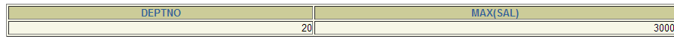
Using the HAVING Clause
SELECT deptno, MAX(sal)
FROM emp
GROUP BY deptno
HAVING MAX(sal)=3000;
Notes:
The HAVING Clause (continued)
The slide example displays department numbers and maximum salaries for those departments whose maximum salary is greater than $10,000.
You can use the GROUP BY clause without using a group function in the SELECT list.
If you restrict rows based on the result of a group function, you must have a GROUP BY clause as well as the HAVING clause.
The following example displays the department numbers and average salaries for those departments whose maximum salary is greater than $10,000:
SELECT department_id, AVG(salary)
FROM employees
GROUP BY department_id
HAVING max(salary)>10000;

Slide 33
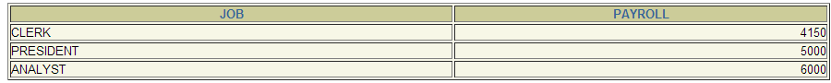
Using the HAVING Clause
SELECT job, SUM(sal) PAYROLL
FROM emp
WHERE job NOT LIKE '%MAN%'
GROUP BY job
HAVING SUM(sal) > 1000
ORDER BY SUM(sal);
Notes:
The HAVING Clause (continued)
The slide example displays the job ID and total monthly salary for each job with a total payroll exceeding $13,000. The example excludes sales representatives and sorts the list by the total monthly salary.
Instructor Note
Demo: 5_job1.sql, 5_job2.sql
Purpose: To illustrate using a WHERE clause to restrict rows by JOB_ID and using a HAVING clause to restrict groups by SUM(SALARY).

Slide 34
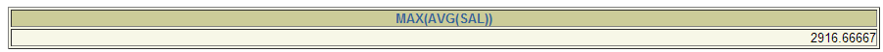
Nesting Group Functions
Display the maximum average salary.
SELECT MAX(AVG(sal))
FROM emp
GROUP BY deptno;
Notes:
Nesting Group Functions
Group functions can be nested to a depth of two. The slide example displays the maximum average salary.

Slide 35
Summary
In this lesson, you should have learned how to:
Use the group functions COUNT, MAX, MIN, AVG
Write queries that use the GROUP BY clause
Write queries that use the HAVING clause
SELECT column, group_function(column)
FROM table
[WHERE condition]
[GROUP BY group_by_expression]
[HAVING group_condition]
[ORDER BY column];
Notes:
Summary
Seven group functions are available in SQL:
AVG
COUNT
MAX
MIN
SUM
STDDEV
VARIANCE
You can create subgroups by using the GROUP BY clause. Groups can be excluded using the HAVING clause.
Place the HAVING and GROUP BY clauses after the WHERE clause in a statement. Place the ORDER BY clause last.
The Oracle server evaluates the clauses in the following order:
1. If the statement contains a WHERE clause, the server establishes the candidate rows.
2. The server identifies the groups specified in the GROUP BY clause.
3. The HAVING clause further restricts result groups that do not meet the group criteria in the HAVING clause.

Slide 36
Practice 5 Overview
This practice covers the following topics:
Writing queries that use the group functions
Grouping by rows to achieve more than one result
Excluding groups by using the HAVING clause
Notes:
Practice 5 Overview
At the end of this practice, you should be familiar with using group functions and selecting groups of data.
Paper-Based Questions
For questions 1-3, circle either True or False.
Note: Column aliases are used for the queries.
Instructor Note
Hint for Question #7: Advise the students to think about the MANAGER_ID column in EMPLOYEES when determining the number of managers, rather than the JOB_ID column.

